Slide 1



Smart UPMC System
Team 9
Notes:
Hello everyone. We all know that UPMC health insurance is an excellent company and have doubled their membership in only 5 years. In order to expend UPMC’s market advantage and retain more healthy customers, we designed this smart system to help you evaluate the customer‘s lifestyle and health condition. Now I am going to introduce you our SMART UPMC health evaluation system.

Slide 2

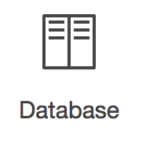
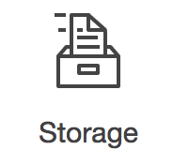


What is Cloud Computing?
Notes:
INTROUDTION: our system is mainly based on cloud computing service. what is cloud computing: Cloud Computing is a kind of service provided by companies like AWS, and shared by everyone. In the cloud platform, we can share resources, software, and information as a metered service over a network, for instance: operate and scale a database in the cloud; back up and storage data in the cloud or coordinate all of the processing steps within an application.

Slide 3




With Cloud computing…
speed
cost
accuracy
Global
Scale
30%
Notes:
With the strong technical support of cloud computing service provider like Amazon, Google or Microsoft, the speed and accuracy of insurance evaluation will be largely increased. Also, since the cloud computing service is shared by people all around the word, companies like UPMC health insurance can save significant IT investment cost , maintenance cost and most importantly. For instance , just in 2014, AWS has reduced the cost of databases ,compute and other services by an average of 30%. So, apparently, by adopting our solution, UPMC will not only improve the health insurance evaluation’s performance, but also save a lot.

Slide 4
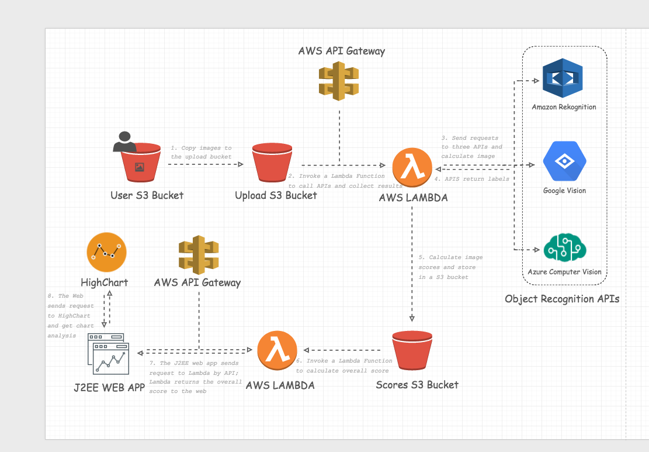
Architecture of our system
Notes:
So here is a demo shows our system’s architecture: As you can see, in the first step, after users upload the pictures, the system will copy images to the upload bucket. After that the system will invoke a lambda functions to call APIs like Amazon rekognition, Google vision and azure computer vision. So that the APIS will calculate the images and return labels like: bread or vegetables. The system will store all the image scores in another S3 bucket and invoke lambda to calculate the user’s overall scores. And when the user clicks to see the analysis, the web page will sends request to lambda by API and lambda will return the overall scores to the user. At the same time, the highchart will also get request and return chart analysis.

Slide 5
Scores&charts
Notes:
Healthscorechart: So here you can see what exactly shows in the website . The user can clearly see his scores of food in the past several months, which can totally encourage them to eat more healthy food and establish healthy lifestyle. Also, in this chart, you can clearly distinguish healthy or unhealthy food pictures from non-food pictures, because they are showed in different colors.

Slide 6
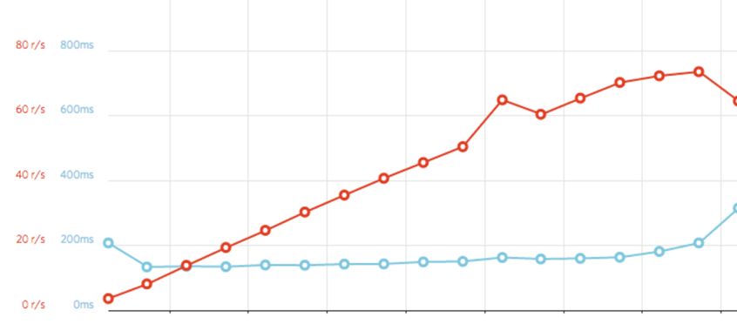
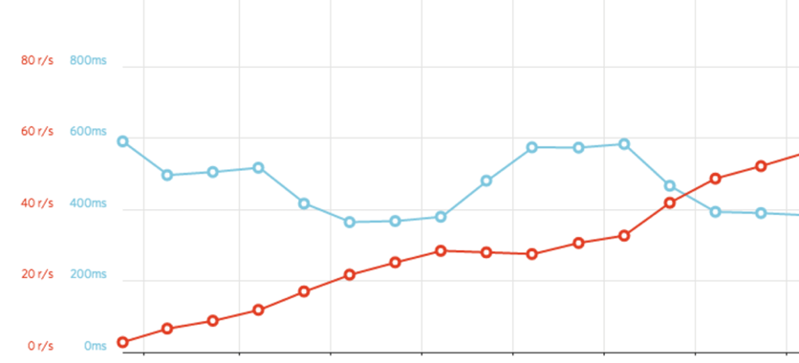
Why choose the AWS Platform & Lambda functions
AWS
Best performance in load test(<200ms);
Lowest pricing： $0.20/1M invocations ；
Most extensive Infrastructure Deployment;
Google Cloud
Notes:
The two charts represent the average response time and the average number of requests per second. Aa you can see, there is a noticeable difference in the average response time between the AWS and google cloud platforms. AWS consistently keeps it between 0-200 ms, but the response time of google cloud platforms is consistently increased. Besides, the pricing is also under our consideration, because aws has the lowest pricing ： $0.20/1M invocations; Also the aws has the most extensive Infrastructure Deployment in over 40 countries, which can definitely support the

Slide 7


- Real-time Assessment - Automatic Generation of Health Reports
Distinctive Advantage of our system
Speed
Accuracy
Multithreading processing
( 1s/per pic)
- 97% accuracy
Algorithm
File Size
- Any picture < 15 M
- Well-designed algorithm
Notes:
Component chosen/discarded / Rationale (e.g lambda you choose, S3 bucket you choose, Database you choose, Among three APIs you give different weighting factor perhaps - or some you discarded; Rationale means a set of reasons - you can bring multiple reasons in terms of Scalability, performance, Cost etc)
Most importantly, we are different from other companies because of our speed: By implementing Multithreading, the system can process one pic in 1 seconds; Furthermore, our system’s accuracy is more than 97% during the daily test. Also, there is almost no size limitations for pictures is our system. Because pictures smaller than 15M can all be processed in the system, so that almost every picture in the Internet can be calculated in this system. Last but not least, our algorithm is well-designed, we give different weighting factor in 3 APIs that we implemented and choose to use Google vision’s tags,which are more detailed and accurate.

Slide 8
Cost Estimation(per 1000 users)
Amazon Web Service
API
EC2
Amazon Rekognition
Chart analysis
LAMBDA
$595
Google Vision
$6765.98
S3 Storage
Training fee
Azure Computer Vision
Maintaining fee
S3 Request
$5852
$5.48
$313.5
Notes:
This cost estimation is based on 1000 users. It consists 4 major parts: The first part is the cost of Amazon Web service includes the cost of EC2, LAMBDA functions, S3 storage and S3requests. The second major part is the cost to invoke the 3 APIs. Including Amazon rekognition, google vision and azure computer vision service. Also, we have training fee, maintaining fee and chart analysis service’s cost. All these cost 6700 dollars, about 6.7 dollars per customers, which is a great deal.

Slide 9
Solution limitation & Incoming improvement
Lack of accuracy of complicated lunch box
Add dietary balance API
Lack of accuracy of food weight
Add calorie measure API
Lack of calculation of calories
Train more data for machine learning
Notes:
Although due to the budget limitation or time, our solution still has some limitations. For instance, our solution might be lack of accuracy in case of too complicated lunch box style since the quantity (calories) of each ingredient we don‘t know and we lack of accuracy of food weight so it’s hard to tell amount of health food item. But if we have more time and budge, we will solve these problems by like adding dietary API, adding calorie measure API or training more data for machine learning.

Slide 10


10
Notes:
UPMC health insurance provides life changing insurance and service,I believe that with our SMART system, UPMC health insurance will attract more prospective customers and make another splendid achievement.

Slide 11
Reference
http://saimedcode.com/wp-content/uploads/2017/04/banner.jpg
http://cdn.idplate.com/images/uploads/139_209_large.jpg
http://ww3.hdnux.com/photos/16/71/52/3906206/7/1024x1024.jpg
https://cdn1.bigcommerce.com/nww20x/ka7ofex/products/1642/images/3674/1128_UHF_Reader_with_Motorola_TC552_1024x768__24580.1411587981.480.480.jpg?c=2
http://im01.itaiwantrade.com/86cdd624-48b7-4cb0-98b2-5d8b67cc6729/7b244429-3fe5-40fa-bbb6-8b5d0e3723e0_DSC04111--360x360.jpg
http://www.healthcarefacilitiestoday.com/media/graphics/2016/12042-Man-in-hospital-eating-healthy-clinic-food-upset.jpg
http://patientsafety.pa.gov/ADVISORIES/Pages/201506_62.aspx
http://www.cnx-software.com/wp-content/uploads/2015/09/Arbox_HTab_Hospital_Tablet.jpg
https://3.bp.blogspot.com/-Oh2LpICutKU/WSSWZHa4uPI/AAAAAAAAVGE/UcdCzD8RGYo5hKgiyawTFR4zILF9EClcQCLcB/s1600/11-chipotle.w710.h473.jpg

